Slide 1


ADVANTAGES & TYPES
DBMS
SOMU P
23071A7245

Slide 2

WHAT IS DBMS?
A Database Management System (DBMS) is software that allows users to define, create, and manage databases. It provides a systematic and organized way of storing, retrieving, and managing data.
Key Features:
Data abstraction
Support for concurrent access
Backup and recovery
Data integrity and security

Slide 3
IMPORTANCE OF DBMS
Efficient Data Management: DBMS reduces data redundancy and ensures data consistency.
Data Security: Access control mechanisms restrict unauthorized users from accessing sensitive data.
Data Integrity: DBMS ensures accuracy and reliability of the data by enforcing rules.
Examples:
MySQL (Open-source, widely used), Oracle DB (Popular enterprise-level DBMS), Microsoft SQL Server

Slide 4
ADVANTAGES OVER FILE SYSTEM
Reduced Data Redundancy: Minimizes data duplication, saving storage space.
Data Integrity and Consistency: Ensures data remains accurate and consistent across the system.
Data Security: Implements encryption and access controls to protect data.
Backup and Recovery: Provides efficient backup and quick recovery in case of system failures.
Concurrent Access: Supports multiple users accessing data simultaneously without conflicts.

Slide 5
TYPES OF DBMS:
Hierarchical DBMS
Network DBMS
Relational DBMS (RDBMS)
Object-Oriented DBMS (OODBMS)
Document-Oriented DBMS

Slide 6
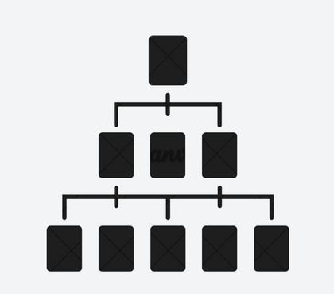
1.HIERARCHICAL DBMS
Organizes data in a tree-like structure where each record has a single parent and multiple children.
Each child can have only one parent, making it a one-to-many relationship.
Example: IBM Information Management System (IMS)
Usage:
Used for large-scale transaction processing.
Commonly used in banking and telecommunications systems.

Slide 7

2.NETWORK DBMS
Supports a many-to-many relationship between entities, where each record can have multiple parent and child records.
More flexible than hierarchical DBMS.
Example: IDMS (Integrated DB Management System)
Usage:
Developed by Computer Associates.
Often used in applications that need to manage complex relationships, such as customer and order systems.

Slide 8

3.RELATIONAL DBMS (RDBMS)
Stores data in tables (rows and columns) and uses Structured Query Language (SQL) for database management.
Relationships between tables are established through keys (primary and foreign keys).
Example: MySQL
Usage:
Open-source and widely used for web applications.
Supports SQL queries for data manipulation

Slide 9
4.OBJECT-ORIENTED (OODBMS)
Stores data in the form of objects, similar to how it’s used in object-oriented programming.
Supports complex data types and relationships, making it ideal for applications that use multimedia, CAD, or simulations.
Example: ObjectDB
Usage:
Pure object-oriented database for Java.
Commonly used in embedded systems and real-time processing environments.

Slide 10
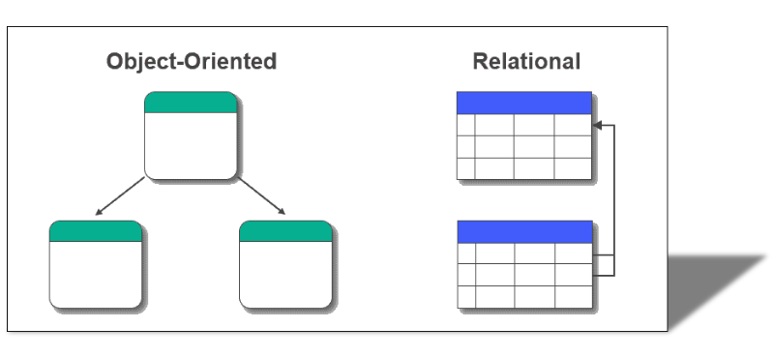
OODBMS VS RDBMS

Slide 11

5.DOCUMENT-ORIENTED DBMS
Designed for storing, retrieving, and managing document-based information, rather than traditional rows and columns.
Each document is a self-contained unit of data.
Example: MongoDB
Usage:
Open-source NoSQL database.
Popular for handling large datasets in web applications and big data environments.

Slide 12
CONCLUSION
Summary: DBMS is essential for efficient and secure data management. It offers clear advantages over file systems, such as reducing redundancy and improving data consistency and security.
Types of DBMS: Each type of DBMS (Hierarchical, Network, Relational, Object-oriented, Document-based) has specific use cases and advantages, making them suitable for different applications.
Future of DBMS: As data continues to grow, DBMS technologies will evolve to meet the demands of data-driven industries.

Slide 13

THANK YOU!

